Slide 1

NO need to
Stress about
Getting a
Good
Evaluator
anymore

Slide 2
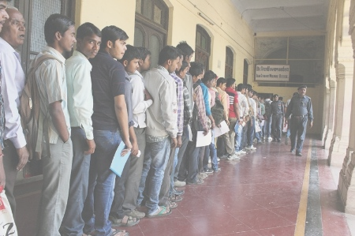
No more long
queues
for revaluation

Slide 3





Real
Check

Slide 4

To provide an automated subjective answer evaluation system.
Unbiased and uniform
for all students.
Purely based on content,
not affected by different types of evaluators-strictness, mood, circumstances
No more revaluation required
Be rest assured that checking is uniform and correctly done

Slide 5

So how does
this work?

Slide 6


Key concepts
Correct
Student
Bank

Slide 7
question
Q1.Explain the
process
of photosynthesis.

Slide 8
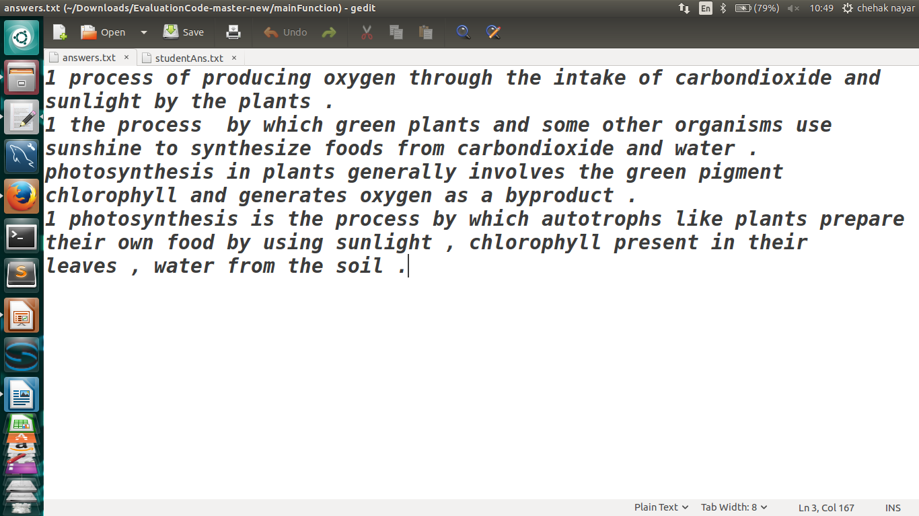
Correct answer database
Question Number

Slide 9
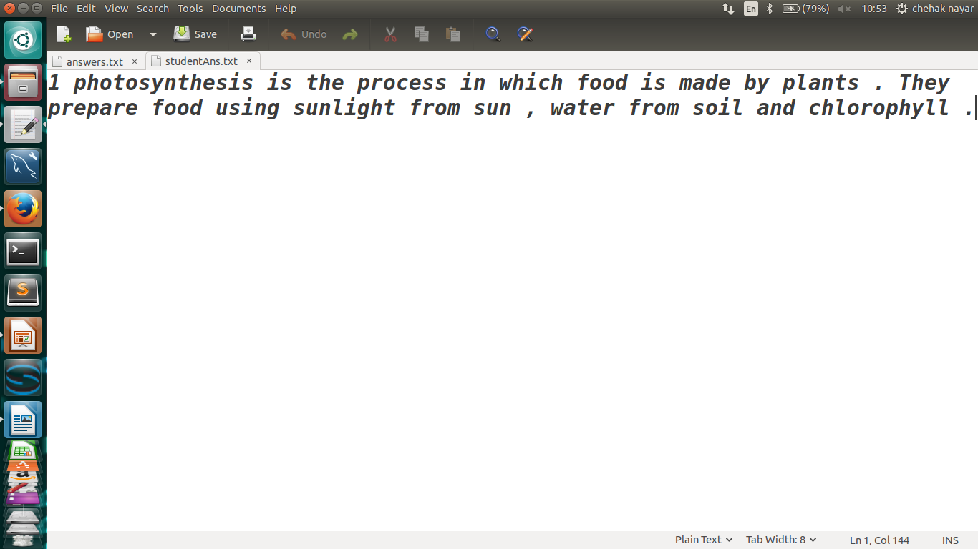
Student answer
Ans to Question Number
Notes:
Take one screenshot for ans written eg- I don’t know the ans.
<number>

Slide 10
The following procedure
Is applied to each answer in ans bank and student answer

Slide 11
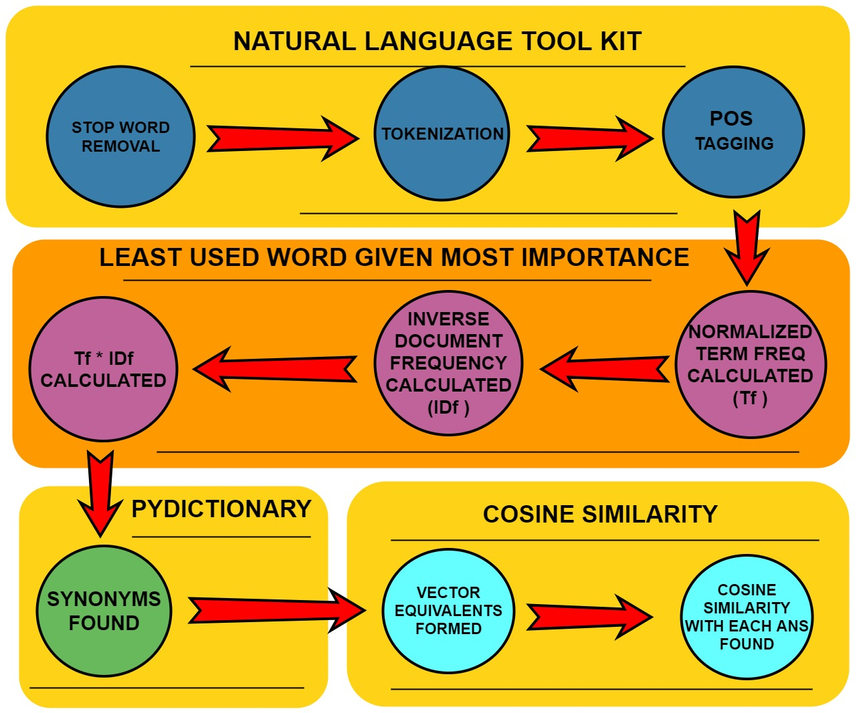

Slide 12
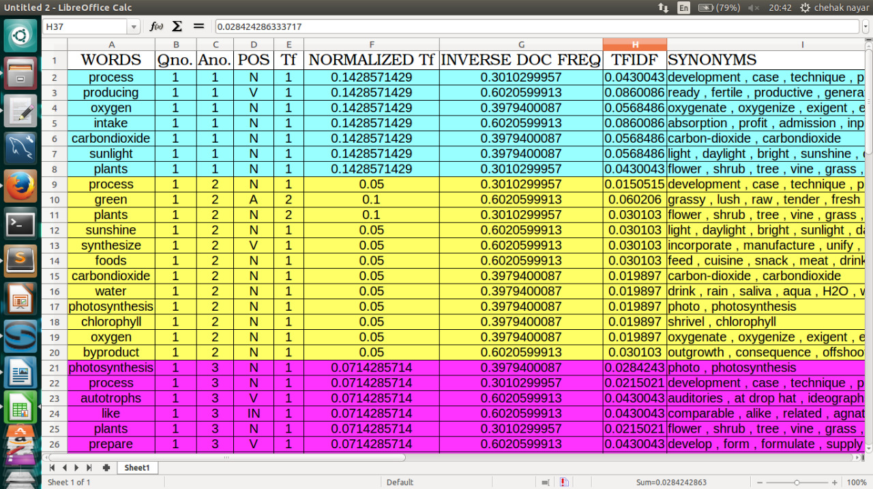
Answer bank

Slide 13
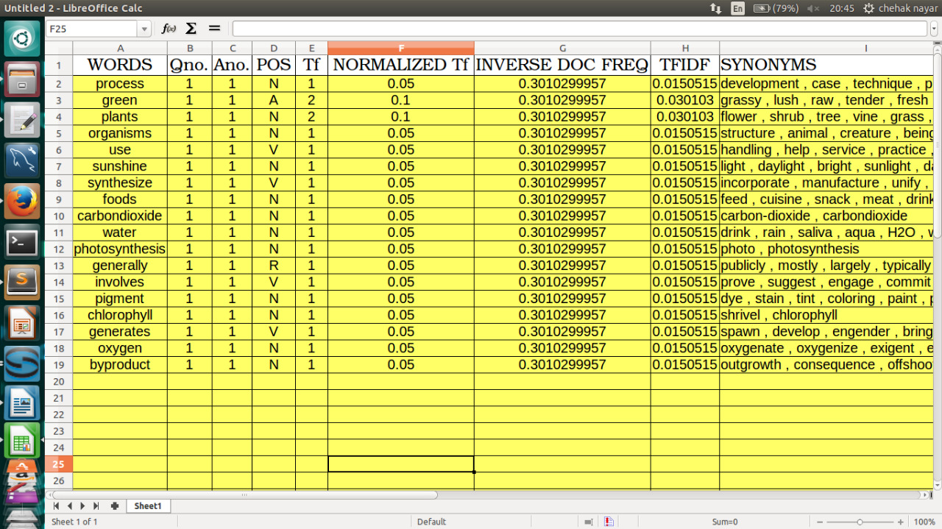
Student Answer

Slide 14
Representing word as a vector
girl
boy
guy
lady

Slide 15
lady
girl
guy
boy

Slide 16
WORD | TFIDF
BOY | a=0.0150
GIRL | b=0.0234
GUY | c=0.0456
LADY | d=0.0352
DIRECTION
i
j
k
l
bj
Each sentence can be represented as ai+bj+ck+…
ai
ck
dl

Slide 17
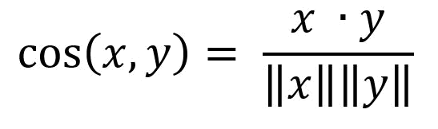
COSINE SIMILARITY is calculated by formula:
x
Where,
x=(ai+bj+ck+…)=student answer
y=(di+ej+fk+…)
=one ans from ans bank
y

Slide 18
While calculating dot product x.y, we consider two words to have same directional vector if:
If both words are the EXACT SAME.
If a SYNONYM is used in the SAME SENSE as the word in correct ans.(POS)

Slide 19
Cosine similarity of the student ans is calculated with each answer in the answer bank.
Most appropriate similarity measure is chosen.

